Slide 2


Hanuma Pedaprolu
Solution Architect

Slide 3
Extracting information from documents leveraging the power of Azure Form Recognizer

Slide 4



What and How are we going to learn?
An AI Solution without prior experience
Key considerations for architecture
Key considerations for deployment
Developers
Architects
DevOps
Engineers
Prebuilt Models
Use of identity document model
Custom Model
Training & Evaluation
Key Considerations
Possible architectural patterns

Slide 5
Documents are everywhere..
Several businesses spend several 100s of hours of human effort in verifying documents and making entries into their online systems
Templated Documents:
Aadhar
Passport
Drivers License
Admission Forms
Invoices
Organizational forms
…more!

Slide 6
What if we were to do it?

Slide 7
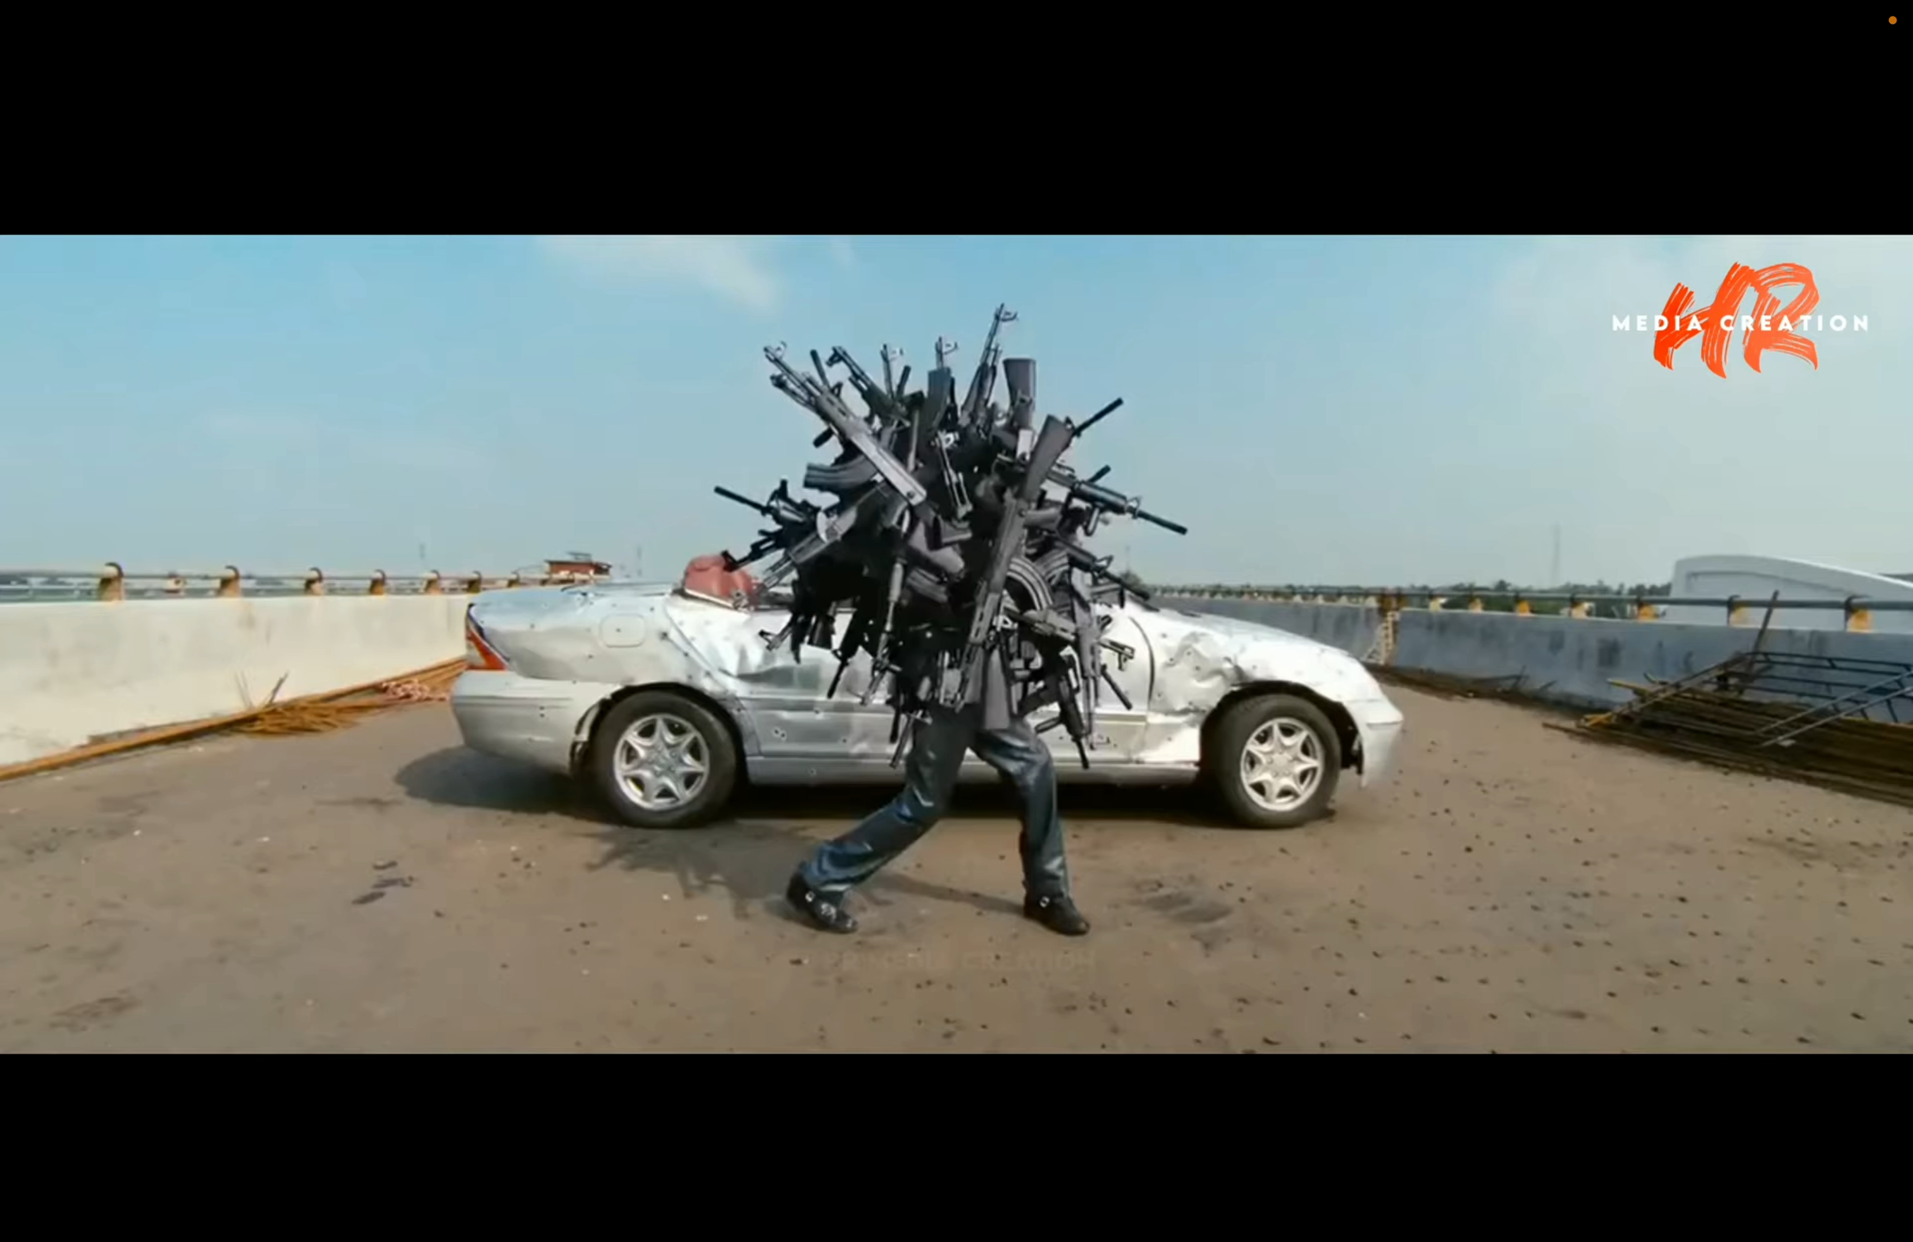

Slide 8




Form Recognizer
Runs in the cloud
Key-Value
Textual Information
Table data
Azure Form Recognizer is a cloud-based Azure Applied AI Service that uses machine-learning models to extract key-value pairs, text, and tables from your documents. Form Recognizer analyzes your forms and documents, extracts text and data, maps field relationships as key-value pairs, and returns a structured JSON output - Source

Slide 9
Demo

Slide 10
Azure Applied AI Services
High-level services
Built on top of Azure Cognitive Services
Out of the box benefits for various scenarios alleviating the pain of developers
Azure Bot Service
Azure Form Recognizer
Azure Cognitive Search
Azure Metrics Advisor
Azure Video Indexer
Azure Immersive Reader
Source - https://docs.microsoft.com/en-us/azure/applied-ai-services/

Slide 11



Azure Applied AI Services
Microsoft has built a few models based on general use-cases. These are known as pre-built models and can be integrated with products directly without any further training.
Business Card
ID Document
Invoices & Receipts
Business Cards
Passport, Drivers License
Sales – Invoices, Sales Receipts

Slide 12


Azure Applied AI Services
Microsoft has built a few models based on general use-cases. These are known as pre-built models and can be integrated with products directly without any further training.
Business Card
ID Document
Invoices & Receipts
Business Cards
Passport, Drivers License
Sales – Invoices, Sales Receipts
Contact Names
First Name
Last Name
Company Name
Department(s)
…
CountryRegion
Date of Birth
Date of Expiration
DocumentNumber
FirstName
LastName
Nationality
Sex
MachineReadableZone
DocumentType
Address
Region
Customer Name
Customer Id
Purchase Order
InvoiceId
….

Slide 13

Bounding polygon

Slide 14

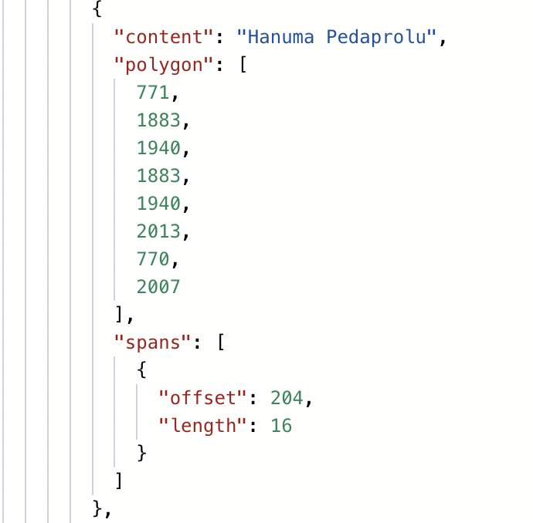
Bounding polygon

Slide 15

Can I train my own model?
Form recognizer has been developed keeping customization aspect at the forefront.
To create a model a minimum of 5 documents are needed..

Slide 16
Demo – Custom Models

Slide 17
Key Considerations

Slide 18
Higher the quality of the document, the better is the result
For best results, provide one clear photo or high-quality scan per document.
Supported file formats: JPEG/JPG, PNG, BMP, TIFF, and PDF (text-embedded or scanned). Text-embedded PDFs are best to eliminate the possibility of error in character extraction and location.
For PDF and TIFF, up to 2000 pages can be processed (with a free tier subscription, only the first two pages are processed).
The file size must be less than 500 MB for paid (S0) tier and 4 MB for free (F0) tier.
Image dimensions must be between 50 x 50 pixels and 10,000 x 10,000 pixels.
PDF dimensions are up to 17 x 17 inches, corresponding to Legal or A3 paper size, or smaller.
The total size of the training data is 500 pages or less.
If your PDFs are password-locked, you must remove the lock before submission.
AZURE form recognizer
Source: https://docs.microsoft.com/en-us/azure/applied-ai-services/form-recognizer/concept-id-document

Slide 19







Real-time integration pattern
YOUR NETWORK
Virus Scanner
Document Store
2
4
1
3
5
Your Application
Web Server
Document Management Service
Form Recognizer
6
7
Rules Engine
Rules Engine DB

Slide 20
Offline integration pattern
YOUR NETWORK
Document Store
1
2
3
Batch Process
Document Management Service
Form Recognizer
4
5
Rules Engine
Rules Engine DB

Slide 21
Q & A

Slide 22
Thank You!
Extracting information from documents leveraging the power of Azure Form Recognizer
Hanuma Pedaprolu
@castasstring
Source Code & Slides
https://github.com/castasint/AzConf-WorkShop

Slide 23





Platinum Partner
Gold Partner
Silver Partner

